Slide 1
Software Testing Life Cycle (STLC)
A beginner-friendly guide with hands-on experiments
GenAI Freshers Batch
Notes:
Welcome learners. Goal: understand how testing is organised, then try it yourself.

Slide 2
What is STLC?
A step-by-step process that tells us what to test, when to test and how to know we are done.
Think of it as...
Who uses it?
Main goal
Cooking a meal: read the recipe, plan, prep, cook, taste, then clean up.
Testers, developers, product owners and QA leads - everyone on the team.
Find bugs early, build quality in and ship software people can trust.
2

Slide 3
SDLC vs STLC
SDLC = how we BUILD software (plan, design, code, test, deploy).
STLC = how we TEST software; it lives inside SDLC.
Testing starts early - not only after coding is finished.
Finding a bug early costs far less than finding it in production.
3

Slide 4
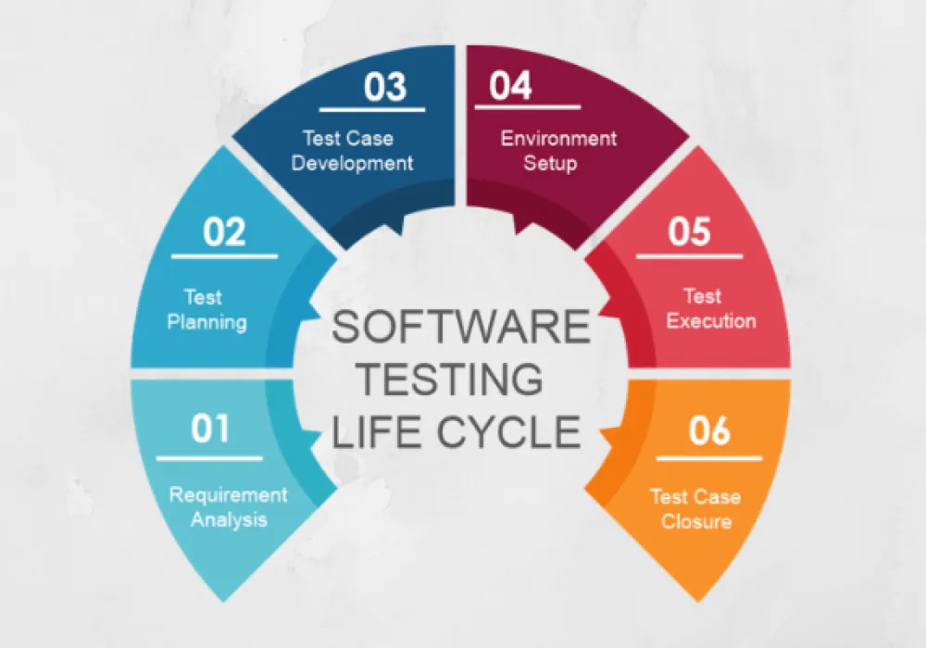
STLC at a Glance
1 Requirement Analysis
Understand what needs to be tested.
2 Test Planning
Decide scope, tools, team and timeline.
3 Test Case Development
Write test cases and test data.
4 Environment Setup
Get the build, devices and tools ready.
5 Test Execution
Run tests, log and retest bugs.
6 Test Closure
Report results and share lessons learned.
4
Notes:
Walk clockwise from 01. Each phase needs the previous one to finish and produces a deliverable. Execution loops back for bug fixing and retesting.

Slide 5
Phase 1: Requirement Analysis
Read the requirement document or user stories.
Find out what is testable and what is unclear.
Ask questions to the BA / product owner early.
Decide which types of testing are needed.
Link each requirement to test cases later (traceability).
Deliverables
Testable requirements list, RTM
Example (login page)
"User can log in with valid ID" is testable. "Login should be fast" is unclear - ask "how fast?"
KEY TAKEAWAY
If you can't understand it, you can't test it. Ask questions early!
Phase ends when
Requirements understood and doubts cleared
5
Notes:
Goal: no guessing. Clarify requirements before writing any test.

Slide 6
Phase 2: Test Planning
Define scope: what to test and what NOT to test.
Choose tools (Excel, Jira, Selenium, etc.).
Estimate effort and set a schedule.
Assign roles to team members.
List risks and how to handle them.
Deliverables
Test plan, effort estimate
Example (login page)
Scope: login + cart. Tools: Chrome + Google Sheets. Team: 2 testers, 3 days.
KEY TAKEAWAY
Testing without a plan is just clicking around. Plan first, test smarter.
Phase ends when
Test plan is reviewed and approved
6
Notes:
The test plan is the roadmap for the whole testing effort.

Slide 7
Phase 3: Test Case Development
Write test cases from the requirements.
Cover positive, negative and boundary cases.
Prepare test data (valid, invalid, empty).
Get cases reviewed by a peer or lead.
Write automation scripts if planned.
Deliverables
Test cases, test data
Example (login page)
Valid login, wrong password, blank username, 50-character password.
KEY TAKEAWAY
A good test case is like a good recipe: clear steps, exact inputs, expected result.
Phase ends when
Test cases are reviewed and approved
7
Notes:
Remind learners: one test case = one clear check with an expected result.

Slide 8
Phase 4: Test Environment Setup
Decide hardware, software, browsers and devices.
Install the build on a test server (not production).
Create test accounts and load test data.
Run a quick smoke test to confirm readiness.
Often done in parallel with Phase 3.
Deliverables
Ready environment, smoke test result
Example (login page)
Staging URL ready, tested on Chrome and Edge, test user created.
KEY TAKEAWAY
A bad kitchen spoils the dish. A bad test environment spoils the results.
Phase ends when
Smoke test passes and build is stable
8
Notes:
If the environment is broken, test results cannot be trusted.

Slide 9
Phase 5: Test Execution
Run test cases and compare actual vs expected result.
Mark each as Pass, Fail or Blocked.
Log bugs with steps, screenshot and severity.
Retest fixes and run regression tests.
Bug cycle: New > Assigned > Fixed > Retest > Closed.
Deliverables
Execution report, bug reports
Example (login page)
TC_LOGIN_03 fails, BUG_101 logged, developer fixes, retest passes.
KEY TAKEAWAY
Testing isn't about proving it works. It's about finding where it breaks.
Phase ends when
All planned tests run and bugs tracked
9
Notes:
This is where most of the hands-on work happens - Experiment 1 practises this phase.

Slide 10
Phase 6: Test Closure
Confirm all tests are done and critical bugs fixed.
Collect metrics: pass %, bugs found, bugs open.
Write the test summary report.
Hold a lessons-learned discussion.
Archive test cases and data for reuse.
Deliverables
Test summary report, lessons learned
Example (login page)
48 of 50 tests passed (96%). 2 low-severity bugs deferred to next release.
KEY TAKEAWAY
You're not done until you've reported and learned something for next time.
Phase ends when
Report is shared and signed off
10
Notes:
Closure is not just paperwork - lessons learned improve the next project.

Slide 11
Example: A Good Test Case
Field | Example
Test Case ID | TC_LOGIN_01
Title | Login with valid username and password
Precondition | User account already exists
Steps | 1. Open login page 2. Enter valid username 3. Enter valid password 4. Click Login
Test Data | user: standard_user / pass: secret_sauce
Expected Result | User lands on the Products page
Actual / Status | (filled during execution) Pass / Fail
Tip: one test case = one clear check. Anyone should be able to run it without asking you.
11

Slide 12
Example: A Good Bug Report
Bug details
Steps and result
ID: BUG_101
Title: Login button does nothing when password has a space
Severity: Medium Priority: High
Environment: Chrome 126, Windows 11
Build: v1.2.0
Steps: 1. Open login 2. Enter valid user 3. Enter password with a trailing space 4. Click Login
Expected: Error message shown
Actual: Nothing happens
Attach: screenshot or screen recording
12

Slide 13
Entry & Exit Criteria (Quick View)
Phase | Entry (can we start?) | Exit (are we done?)
Requirement Analysis | Requirements document available | Testable list agreed
Test Planning | Requirements analysed | Test plan approved
Test Case Development | Test plan ready | Test cases reviewed
Environment Setup | Plan + cases ready | Smoke test passes
Test Execution | Env ready, build delivered | All cases run, bugs logged
Test Closure | Execution complete | Report signed off
13

Slide 14
Common Types of Testing
Smoke
Sanity
Functional
Quick check: does the build basically work?
Check a small fix or change works.
Does each feature do what it should?
Regression
Performance
UAT
Did the new change break old features?
Is it fast and stable under load?
Final check by real users or client.
Manual testing = you run steps by hand. Automation = a script runs them for you.
14

Slide 15
Who Does What? Deliverables per Phase
Phase | Main activity | Deliverable
Requirement Analysis | Study requirements, raise questions | Requirement traceability matrix (RTM)
Test Planning | Estimate effort, pick tools, assign roles | Test plan, effort estimate
Test Case Development | Write and review cases and data | Test cases, test data
Environment Setup | Install build, configure devices | Ready environment, smoke result
Test Execution | Run tests, log and retest bugs | Execution report, bug reports
Test Closure | Analyse results, hold review meeting | Test summary report
Roles: Tester (writes and runs), Test Lead (plans), Developer (fixes), Product Owner (clarifies).
15

Slide 16
Quick Glossary
Term | Meaning
Bug / Defect | Difference between expected and actual behaviour
Severity | How badly the bug hurts the system
Priority | How soon the bug should be fixed
Test Suite | A group of related test cases
Traceability | Linking each requirement to its test cases
Hallucination | AI giving confident but wrong or made-up answers
Prompt | The instruction or question given to an AI model
16

Slide 17
STLC for GenAI Applications
What changes?
Extra checks
AI answers can vary each time, so we test quality, not just exact output.
Accuracy, hallucination, bias, safety, tone and prompt robustness.
Test data
Bonus
Use varied prompts: normal, tricky, empty, very long, off-topic.
AI can help write test cases - but humans must review them.
17

Slide 18
Experiment 1: Mini STLC on a Login Page
Pick any demo site, e.g. saucedemo.com (practice login page).
Requirement analysis: list 5 things the login should do.
Write 10 test cases in a sheet: ID, steps, data, expected, actual, status.
Include negative cases: wrong password, blank fields, SQL-like text.
Execute them and log at least 2 bugs/observations.
Write a 5-line test summary report.
You deliver
Excel sheet with test cases + a short summary.
Time: 45 minutes
Tools: browser + Excel/Google Sheets
18

Slide 19
Experiment 2: Test a GenAI Chatbot
Choose any chatbot (Claude, ChatGPT or Gemini).
Design 10 prompts: 3 factual, 2 ambiguous, 2 off-topic, 2 harmful-request, 1 very long.
Define expected behaviour for each BEFORE running.
Run each prompt twice - is the answer consistent?
Score: accuracy, safety, tone (1-5) and note failures.
Bonus: ask AI to generate test cases for the login page, then compare with yours.
You deliver
Scorecard table + 3 learnings.
Time: 45 minutes
Tools: any chatbot + Sheets
19

Slide 20
Key Takeaways
STLC = 6 phases: Analyse, Plan, Design, Setup, Execute, Close.
Test early, test often, and write clear test cases.
Every phase has an input and a deliverable.
GenAI apps need extra testing for accuracy and safety.
Practice with the experiments and share your findings!
Questions?
20

